Slide 1
Gaining a Footing in the Landscape of Learning Ecologies
SLIDES
https://learningecologies.weebly.com/

Slide 2
Meaning – based on biological understandings of how organisms live and behave in the natural world e.g. ecosystem, ecotone
Model – relates abstract understandings to human situations. Tools to enable parts, interactions, activities and scope of a system of interest to be specified and understood in a particular domain.
Metaphor – for a type of structure or behaviour – sustainable, resilient, fragile
Mars et al – map similarities & differences between natural and organisational ecosystems
Pickett, S. T. A. and Cadenasso, M. L. (2002). The Ecosystem as a Multidimensional Concept: Meaning, Model, and Metaphor
Mars, M.M. et al (2012) The value of a metaphor: Organizations and ecosystems

Slide 3
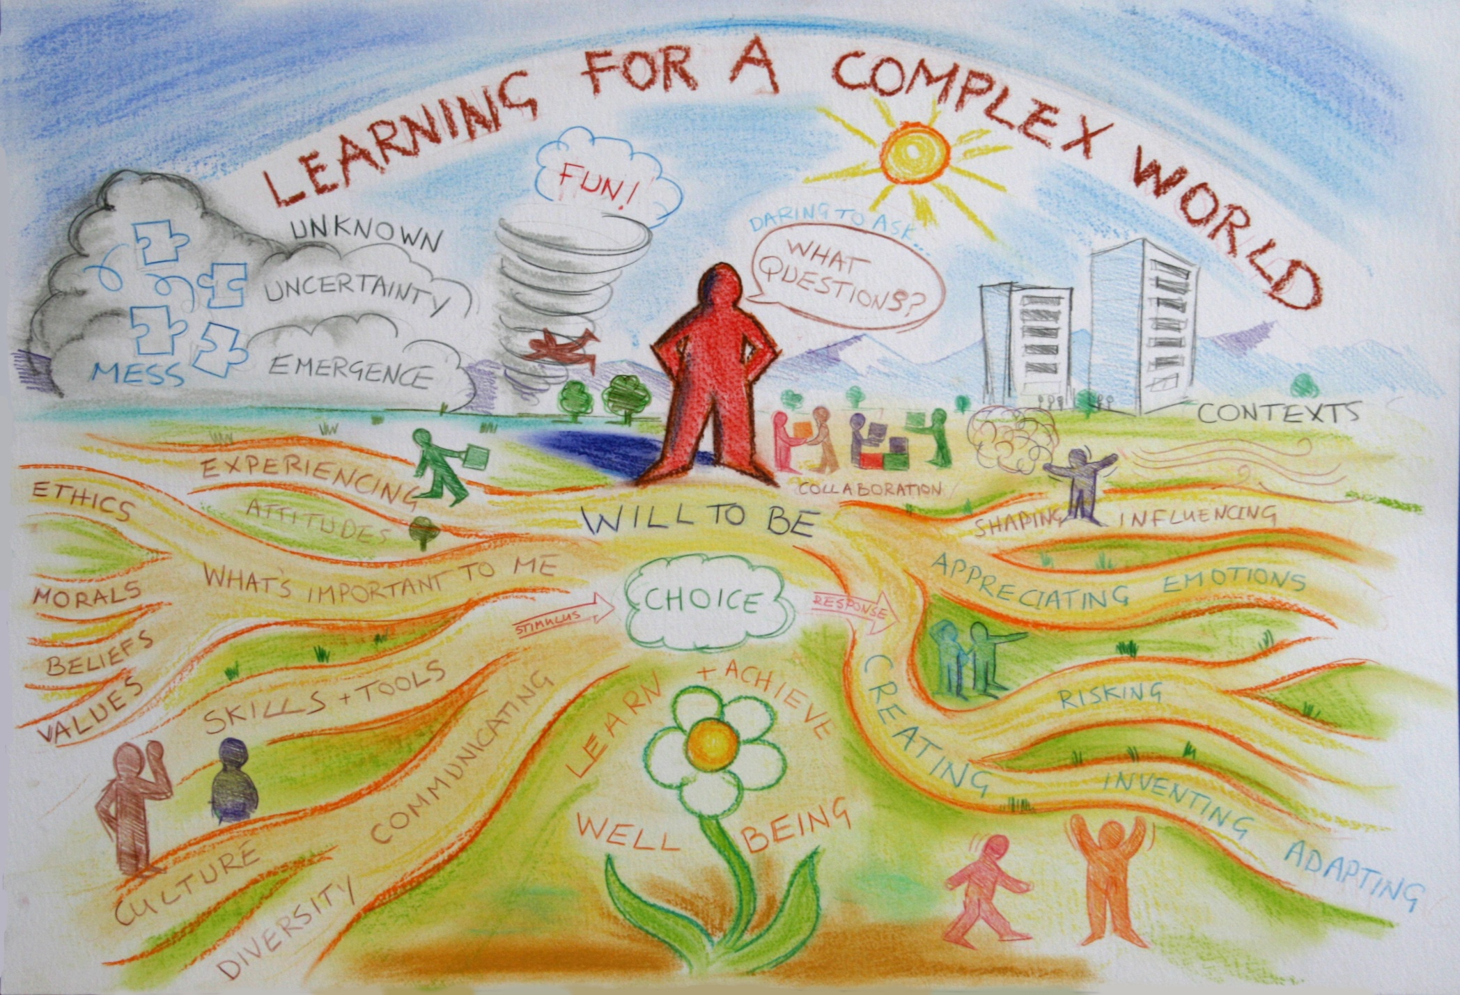
me 1978

Slide 4
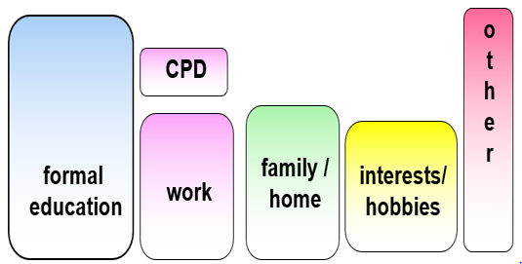
CREATING MEANING EVERY DAY ACROSS THE WHOLE OF OUR LIVES
Lifelong learning: All learning activity undertaken through life
Now, All, Personal & Significant –necessary for present & foundation for the future
Formal / non-formal
Individual
Intended
Need
Directed
Planned
Extrinsic Motivation
Cognitive
Informal
Social
Unanticipated
Interest
Self-directed
Emergent
Intrinsic Motivation
Emotional

Slide 5
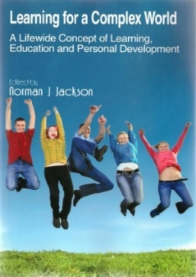
The whole of life is learning therefore education can have no endings
Eduard Lindeman
Academic
curriculum
UNIVERSITY
ECOSYSTEM
Extra-curriculum
Part-time work
and internships
Managing own life
Study
programme
/modules
Co-curriculum
Organised
learning
outside
formal
curriculum
Caring for others
Running own
business
Work-related curriculum
Placement Internship
Apprenticeship
Participating in Sport
Volunteering &
social enterprise
May include fieldwork,
projects in
real world,
study abroad, community projects
Travel
Mentoring
Creative activity
Student Representation
& Societies
Study abroad
AN MORE!!!
World of infinite possibilities for learning

Slide 6
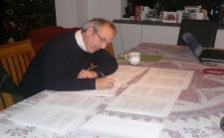
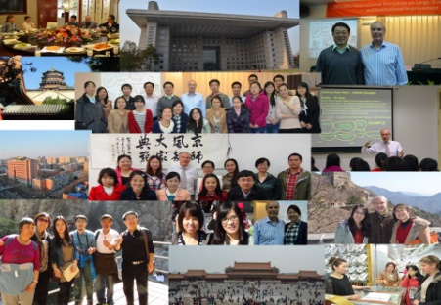
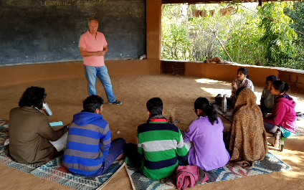
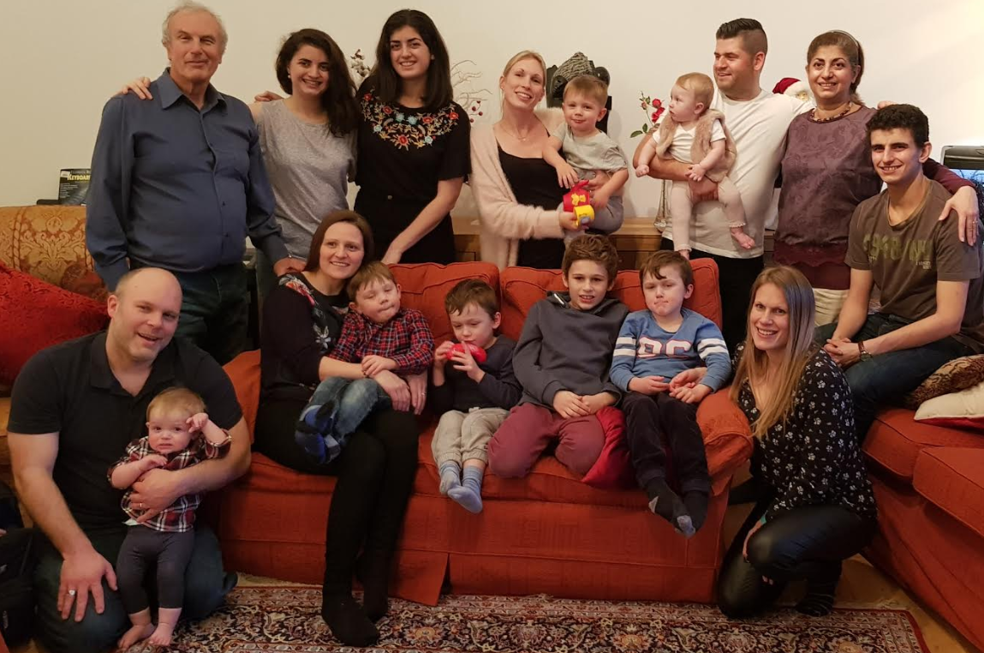
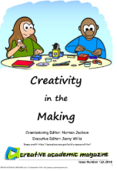
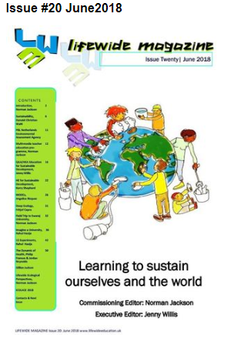
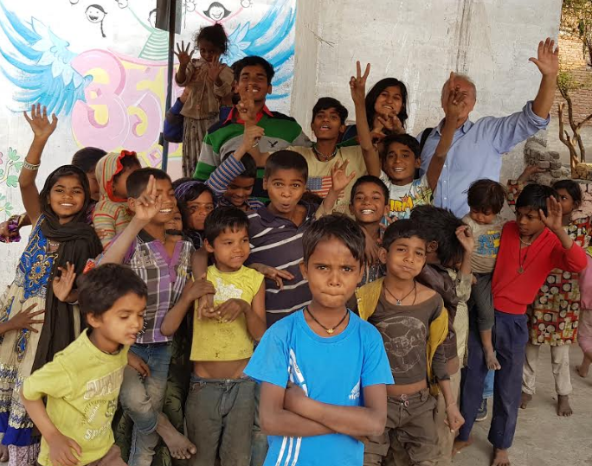
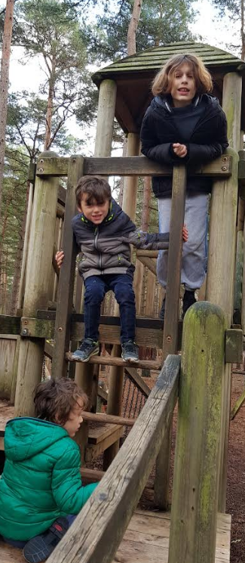
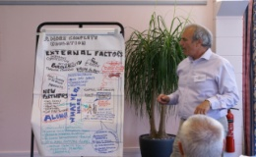
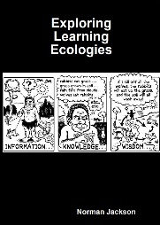
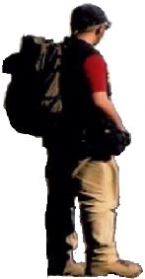
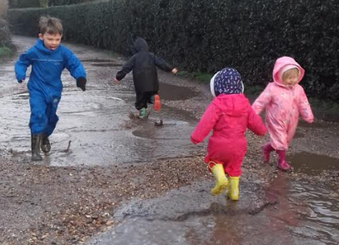
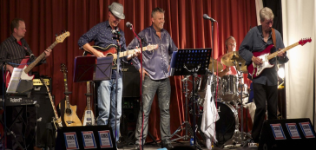
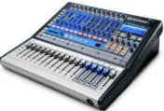
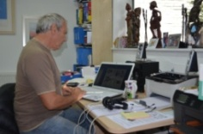
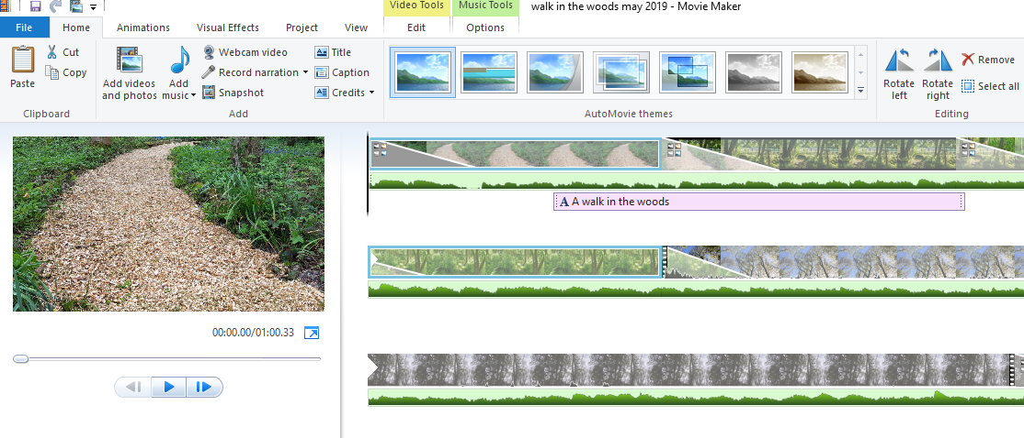
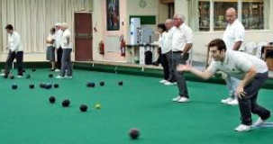
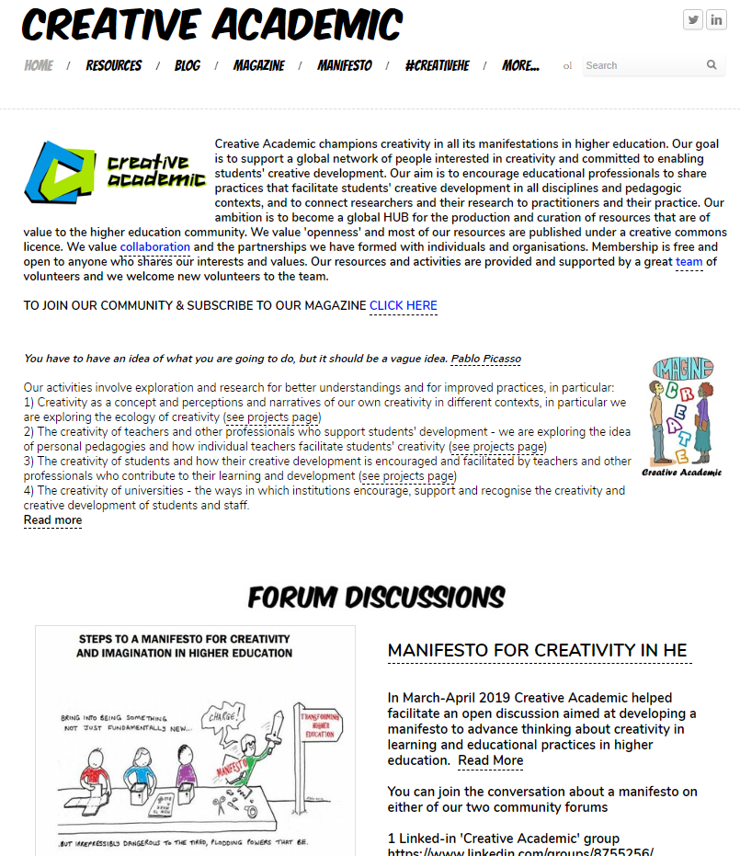
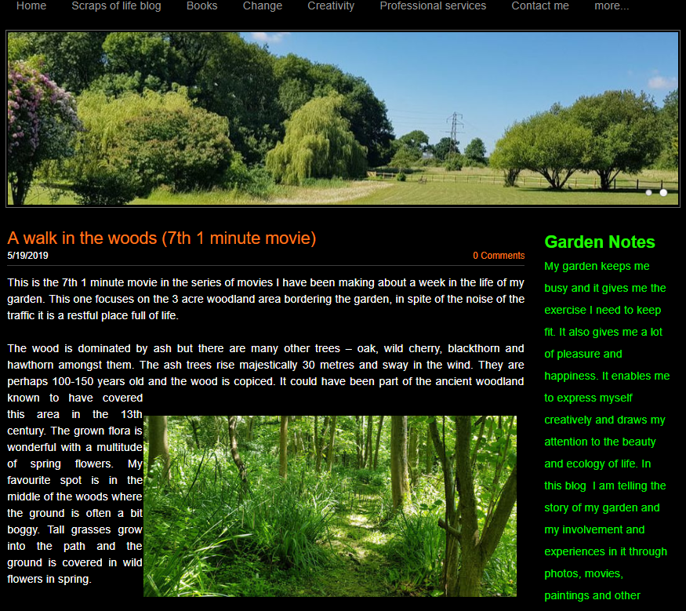
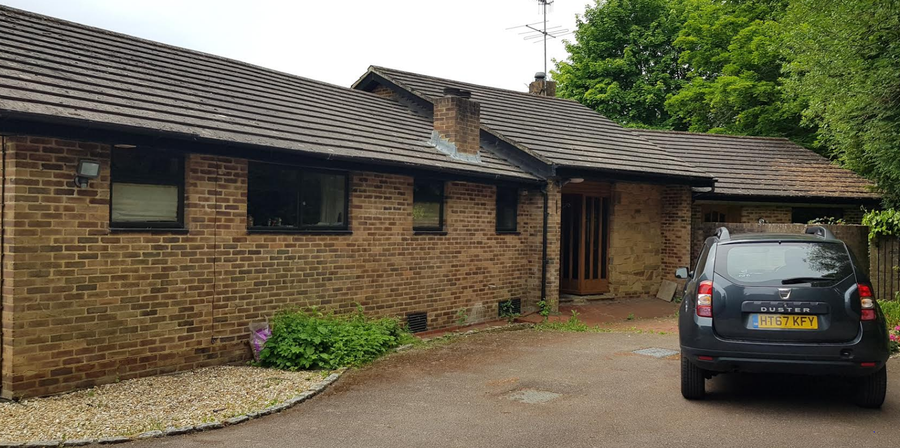
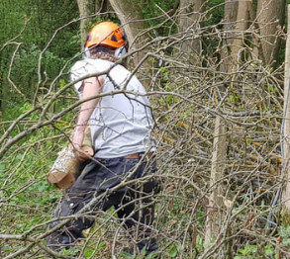
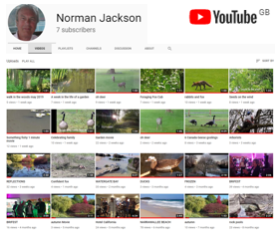
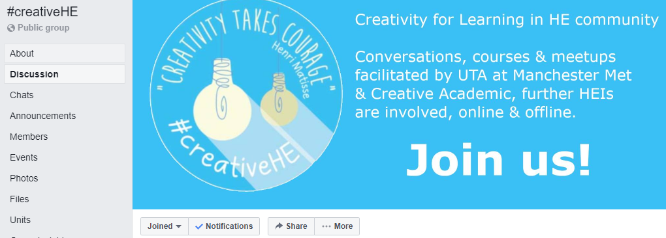
family & home
travel – encountering other cultures
interests & hobbies
work
virtual
LIFEWIDE

Slide 7
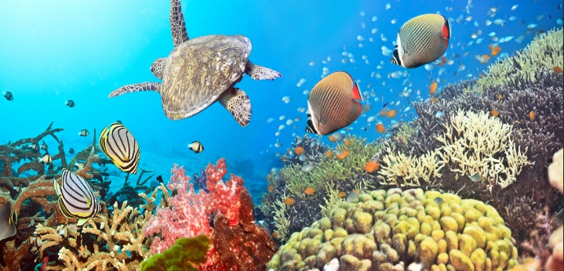
A natural ecosystem comprises the complex set of relationships and interactions among the resources, habitats, and residents of an area for the purpose of living.
A human ecosocial system comprises the complex set of relationships and interactions among the human inhabitants, resources and habitats of an environment for the purpose of > performing, producing, making, creating, learning, developing and achieving
Ecosocial systems for the making and remaking of meaning
Lemke, J. L. (1997). Cognition, context, and learning: A social semiotic perspective

Slide 8
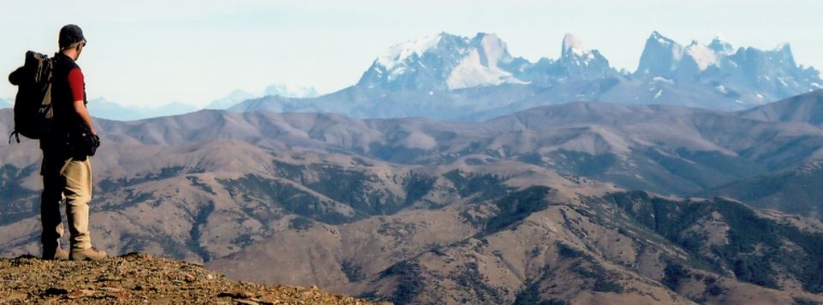
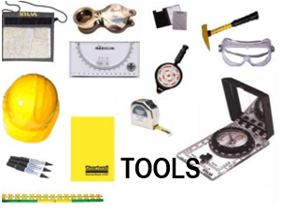
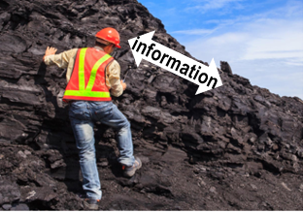
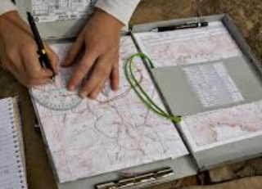
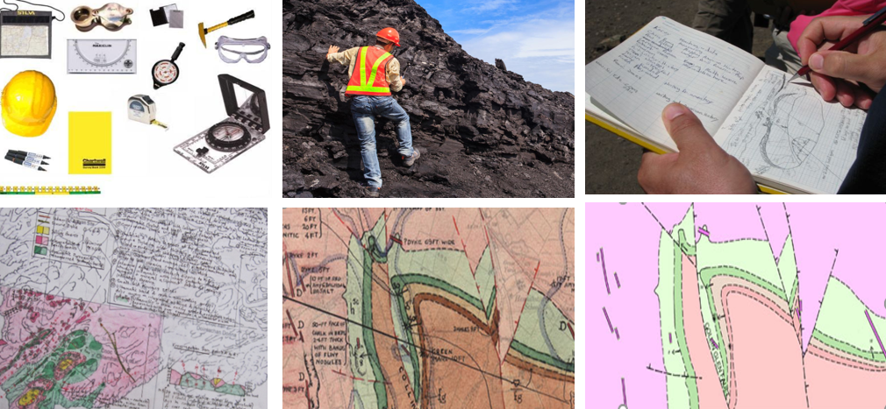
information
information
TOOLS
KNOWLEDGE
KNOWLEDGE
KNOWLEDGE & NEW VALUE
KNOWLEDGE & NEW VALUE
KNOWLEDGE & NEW VALUE

Slide 9
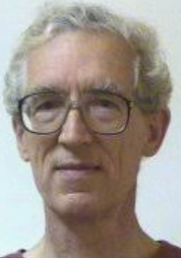
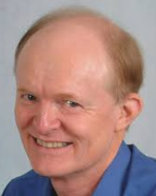
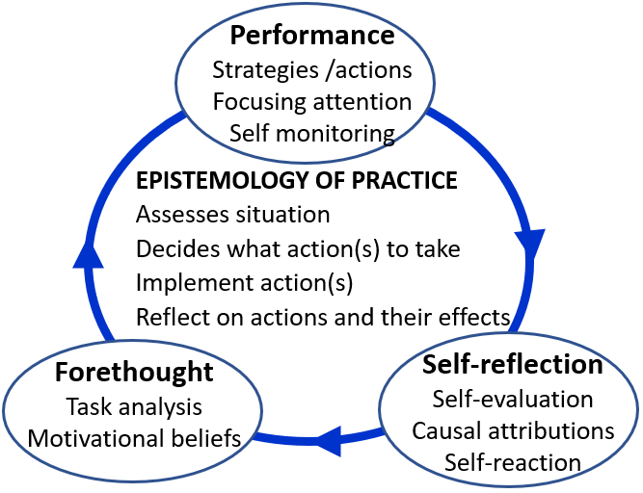
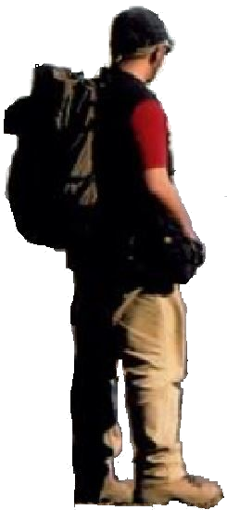
Michael Eraut
Barry Zimmerman
Eraut, M. & Hirsh, W.(2008) Significance of Workplace Learning for Individuals, Groups & Organisations Zimmerman, B. J. (2000) Self-regulatory cycles of learning.

Slide 10
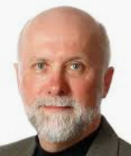
Environment
SEEK
Codified
Information
& Knowledge
People
help/feedback from
knowledgeable
individuals
Harold Jarche
evaluate
information
construct own
knowledge
SENSE
create new meaning
open access
do something with knowledge
SHARE
CREATE NEW VALUE
Embody learning in performance
& the MAKING of artefacts
selective access
Jarche, H. (2014) The Seek > Sense > Share Framework

Slide 11
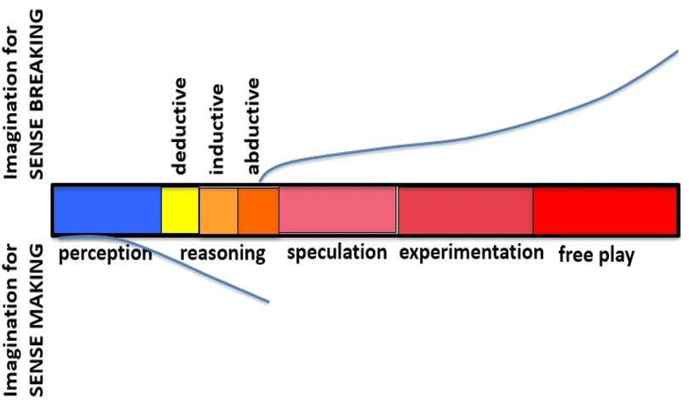
Codified situated learning
The geologist’s cognitive spectrum as he implements his
ecology of practice
Diagram adapted from
Pendleton-Jullian & Brown (2016)
‘Pragmatic Imagination’ p68-9

Slide 12
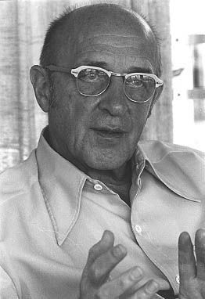
'the emergence in action of a novel relational product growing out of the uniqueness of the individual on the one hand, and the materials, events, people or circumstances of [their]life'
Carl Rogers (1960)
Our expressive and pragmatic creative responses emerges from our uniqueness as individuals, relating to, caring for and thinking about the things that matter to us in particular contexts and situations.
Originality emerges from our ecology of practice that enables us to develop the situational understandings to act and thoughtfully and skilfully WEAVE together particular ideas/emotions/things/people and much more to create new meaning and value.
Notes:
There are many definitions of creativity and most seem to have the ideas of bringing something new and original into existence as their core conception without providing any sort of context. It’s as if creativity and invention happen in isolation from the world of their creator. Because of this I have come increasingly to appreciate and respect the way Carl Rogers framed the idea of personal creativity as, 'the emergence in action of a novel relational product growing out of the uniqueness of the individual on the one hand, and the materials, events, people, or circumstances of his life' ^{27:350}
The bottom line is that creativity is an ecological phenomenon. It’s about human beings having thoughts that are stimulated by their relationship and interactions with the world around them. A creative thought is the result of a person interacting cognitively, physically, emotionally, virtually with something in their world ideas, people, things, problems, situations and experiences, and a multitude of other things and this interaction triggering a novel thought. These thoughts are often the result of connecting/combining two or more things to create something that is different to the things that were connected. McWilliam and Taylor⁶ catch this beautifully in their idea that creativity is often the result of making a third ‘thing’ from two existing things or ideas, rather than making something from nothing. Perhaps we might capture the idea in 1+1=3!
Rogers' view of personal creativity and how it emerges from the circumstances of our life, is an ecological concept. The ecological metaphor affords us the most freedom and flexibility to explore and appreciate the ways in which we and our purposes are connected to our experiences and the physical, social and psychological world we inhabit. I believe that our creativity lies in seeing affordance in an idea, thing or situation and then acting on this
affordance by doing something useful and novel (at least to ourselves) with what is afforded²⁹. If we translate this way of thinking to the formal teaching and learning environment then the most important things a teacher does through their pedagogic practice is to create affordance for learning, enable learners to appreciate that affordance, and equip them with the means and motivation to make use of it. If the object of affordance has a creative dimension then their pedagogic task is to encourage and enable learners to make use of it.
A learning ecology contains not only the physical, virtual and social spaces that form the circumstances of our lives, but also the mental / psychological spaces that enable us to think about ideas and situations in a variety of ways. If we translate this way of thinking to the formal teaching and learning environment then the most important things a teacher does through their pedagogic practice is to create affordance for learning, enable

Slide 13
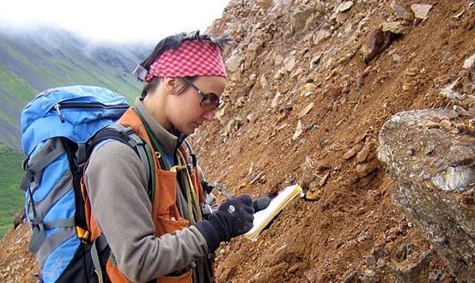
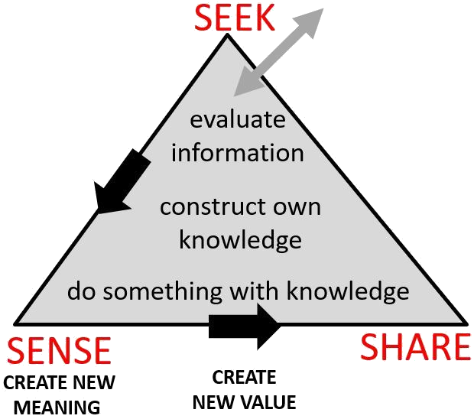
PLACE & SPACES
He inhabits the only place where he can make this particular map. As he begins his project he enters a liminal space. His cognitive spaces are rich in curiosity, inquiry, analysis and imagination.
RESOURCES
He draws on his own embodied knowledge and experiences and the codified knowledge of those who have mapped and studied his field area. Through his purposeful presence he accesses the information contained in the landscape and materials which flows into him through sight, touch and sound, to fuel his perceptions and engage his sense making. He wears clothes appropriate for the weather and terrain. He uses tools like a camera, hammer, hand lens, compass, map case, binoculars, notebook, base maps. aerial photos, rucksack and more. He uses off-road vehicles and equipment to camp and sustain himself.
RELATIONSHIPS
His presence in the landscape enables him to form relationships with the materials, landforms and the problem he is solving. The tools he is using and the artefacts he is creating become part of him.
AFFORDANCES
The possibilities for thinking & action are in the TASK to create a geological map, in the landscape – rocks and soils, in the tools and technologies he uses and in the artefacts he creates.
PAST
FUTURE
PROCESSES/ACTIVITIES
His interactions with his environment
are not random. He creates a process
for systematically and skillfully exploring, observing, recording and analyzing the geology in order to solve his puzzle and create a geological map.
NEW VALUE & MEANING
Through skilful and thoughtful interactions with his environment he creates new meaning and value & becomes a better version of himself.
He uses his mind and body to create and inhabit an ecology of practice in order to interact with his environment to make a geological map. The way he interacts (his performance) has been developed through past experiences and performances. What he thinks and does is influenced by his interactions and his emergent understandings and feelings as he walks and climbs, observes, records and thinks. His understandings are influenced by the information flows he accesses. His perception, reasoning, and imagination, his will, beliefs, values, emotions, creativity, confidence, self-belief, self-awareness and ability to regulate himself are all involved as he works to achieve his goals using the tools of his field craft.
CONTEXTS
The challenge of making a geological map in an unexplored landscape. His organization's
surveying / exploration project. His ambition to create a better version of himself.
Notes:
A geologist might be given the task of creating a geological map where none exists or creating more detailed maps where they do exist. In order to achieve this they will create an ecology for learning. Prior to going into the field a geologist will gather existing information about an area they are intending to map, acquire base maps if they exist or use aerial or satellite photographs if none exist. These are resources and tools that the geologist uses to record observations about what is found and enable such information to eventually be turned into a map. They will develop a strategy for tackling the problem and plan logistics like how and where they will live in the field, how much food and water they will need, how they will get there and move around, how they will communicate etc..
The thought processes of a geologist (any natural scientist) move along the cognitive spectrum of perception (observation informed by lots of knowledge gained through study and experience), imagination (conceptualisation of what is observed) and reasoning (the critical evaluation of what is observed). We might also throw in reflection on what has been understood to try to make more sense of it.
The body has to work hard to perceive - physically the geologist has to get into the field to see the rocks he is interested in, to see and measure the structures and the relationships between different types of rocks, to take samples for further analysis, and to record these things on a map.
Being a geologist involves quite a lot of physical labour and performing particular routinised actions - like locating their positions on a map or aerial photograph made easier with GPS navigational aids, measuring the dip and strike of bedding in rocks, breaking rocks and examining fresh surfaces with a hand lens, photographing and sketching rock outcrops and annotating sketches with observations, and where there is little outcrop examining the soils.
This observational process is integrated with imagination - the geologist tries to solve a 3 dimensional puzzle with only bits of information and lots of gaps. He tries to understand the relationships between one type of rock and another and develop understanding of the geological history of the area. So conceptualisation - the building of working hypotheses to explain the geology goes hand in hand with the perceptual-observational process. And as a hypothesis forms the body is involved in testing it. A geologists mind has to enable him to go as he engages systematically with his problem. His body gets his senses and his mind to the places he needs to be in order to find the evidence that confirms his hypothesis or not. Past experience has shown me that there is much intuition involved in this process. Sometimes it just feels right to do something.
The geologist's observations and recording enable him to relate and synthesise disparate pieces of information to create a bigger picture. And after the day, back at camp, there is the pondering and reflection on what has been seen as the day's observations in notebooks are revisited and plotted on the base map. These analytical and conceptual processes continue after the field as samples are analysed and understood better. These elements of cognition, doing and being work together in a merry dance and the knowledge and understanding that is created, together with new artefacts through which this knowledge is communicated (maps and reports) is the creative outcome of this process.

Slide 14
3 RESOURCES
information, knowledge, people, tools, technologies
& other artefacts (anything that can be used)
2 AFFORDANCES
possibilities that can be perceived or imagined for thinking and action
4 SPACES
physical, social, virtual, intellectual, psychological, liminal
WHOLE PERSON
with their mind and body, purposes and motivations, seeking, sensing, perceiving, feeling, imagining, relating to, interacting with their environment, interpreting & making sense of their situations & weaving together things that matter to
ENVIRONMENT
1 CONTEXTS
situations, circumstances, culture, ourselves, problems/ opportunities -
PAST
5 PLACES
significance of place for situational learning
FUTURE?
PERFORM
LEARN & CREATE
MEANING &
NEW VALUE
6 RELATIONSHIPS
with people, communities, places, ideas, objects, work, hobbies, problems, anything!
7 PROCESSES/ACTIVITIES/EXPERIENCES
eg study, work, making, research, inquiry, problem
solving and much more, SEEK, SENSE, SHARE
Notes:
Summary of the components of a learning ecology
Learning ecologies (Jackson 2013a:14) 'the process(es) we create in a particular context for a particular purpose that provides us with opportunities, relationships and resources for learning, development and achievement'.
This definition represents the integration and interdependence of the elements of learning and achievement which include the contexts and spaces we inhabit, including our history, relationships and resources, (the most important being knowledge and tools to aid thinking), and our will and capability to create a learning process or learning ecology for a particular purpose.
Such actions may be directed explicitly to learning or mastering something but more likely they will be primarily concerned with performing a task, resolving an issue, solving a problem, or making the most of a new opportunity.
Learning ecologies have temporal dimensions as well as spatial and contextual dimensions: they have the capability to connect different spaces and contexts existing simultaneously across a person's life-course, as well as different spaces and contexts existing in different time periods throughout their life-course.
HYPOTHESIS : ECOLOGIES FOR ACHIEVING OUR PURPOSES
ARE OUR VEHICLES FOR DISCOVERING & CREATING MEANING
Our beliefs shape what we value and what we value shape our beliefs
Our beliefs & values shape our purposes – purposes emerge from the circumstances of our life and what we value they give our life meaning
Purposes create intentions (will/desire/ambition) to act on purpose (to reinforce the meaning that is our life) eg the desire to make a positive contribution/to make a difference to create a better version of oneself and to create new value in the world we are attending
Intentions cause us to search our life/world (contexts) for affordance (perceptions of possibility for action – eg to make a difference)
Affordance enables us to formulate goals to drive specific actions and behaviours in the particular contexts and situations of our life/world
These actions and behaviours result in an ‘ecology for achieving our goals’. Our ecology is the way we interpret, relate to, connect and interact with our world of which we are a part not a separate entity. Our ecology involves relationships, activities, experiences, use of resources (knowledge/tools and other artefacts) through which we learn and develop in order to accomplish something we value and create new and deeper meanings in the process.
New meaning grows from the experiences and reflections on experience grown through our ecology when it is integrated with our previous understandings, values and beliefs. Our unfolding experiences contain things which are currently meaningful and also things that do not make sense to us. It is in striving to make sense or better sense of such things that new meaning grows in relation to all of the above. Its an ecological process.

Slide 15
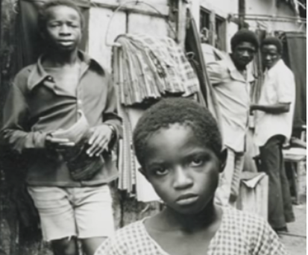
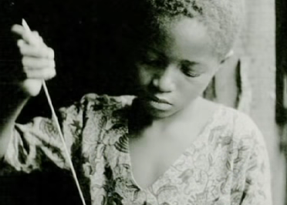
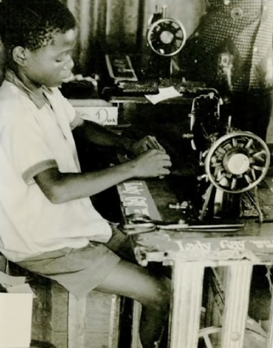
TAILORS ALLEY MONROVIA
Periphery
Novice
Advanced beginner
Competent
Proficient
Expert
social
practice
situated
learning
participation
Lave, J. & Wenger, E. (1991) Situated Learning: Legitimate Peripheral Participation.

Slide 16
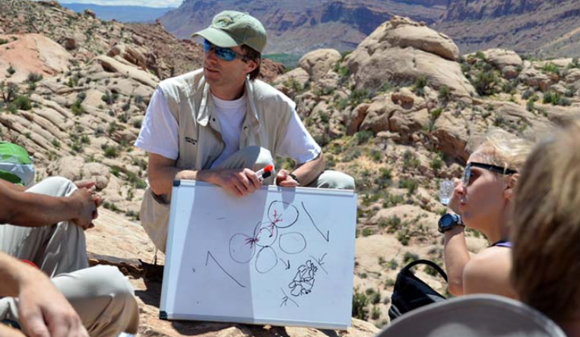
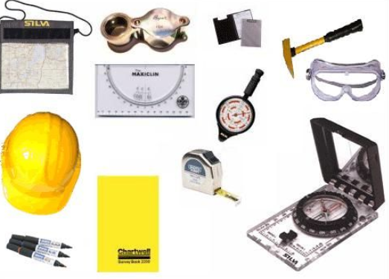
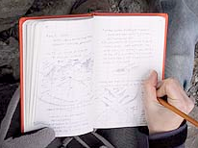
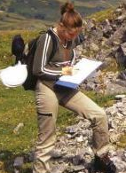
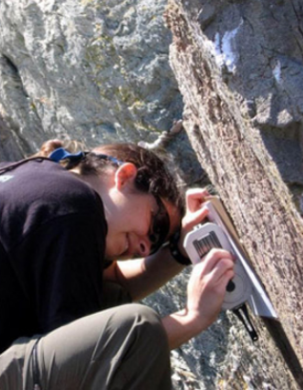
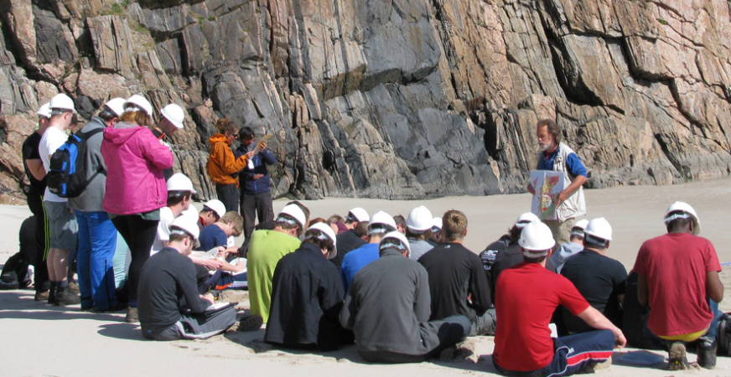

Slide 17
SOCIETY social / cultural / political / technological / economic influences
SYSTEM other companies & public organisations providing services
clients – e.g. Governments & Int Corporations, World Bank, Investors
FIELD – Professional Body, peer networks, wider community of practitioners
Codified knowledge of the discipline – maps and documents relevant to work
ORGANISATION – provides a commercial or public service context
provides a social, cultural, technological, economic environment
Field environment
Laboratory/Office
laboratories,
facilities,
resources,
managers,
geologists,
technical &
admin
support
A GEOLOGIST’S ECOLOGY OF PRACTICE
Learning how to create an ecology of practice through a programme of university education & training in a
Community of Practice

Slide 18
SPACES
Physical
Virtual
Intellectual
Creative
RESOURCES (knowledge, tools, artefacts, technologies) teachers’ embodied knowledge, students own knowledge & experiences, explicit knowledge in books/articles, internet resources
AFFORDANCES
In the courses/ modules, activities teachers create,
In the resources inside/outside HEI
In peer groups.
RELATIONSHIPS
teacher -students
students & peers
students & others
who support their
learning
CONTEXTS
Institution
Subject/discipline
Course/programme
Teacher’s own goals
and aspirations
PROCESS
Forms of teaching – sage, guide, meddler
Nature of teaching activities & forms of learner engagement especially nature of independent work & peer collaboration
NEW VALUE
Students’ learning
and development

Slide 19
Determined by learner
B Partly to significantly determined
by learner(s)
D Completely determined
by learner
Academic
Programme
Other Contexts
eg. work, community
field, co-curriculum
extra-curriculum
LEARNING CONTEXT
LEARNING ECOLOGY
C Partly to
significantly
determined
by learner
A Completely determined
by teachers
Determined by institution or
other external organisations
eg a work placement or
volunteering organisation
Learning ecology includes goals, affordances, processes, spaces, relationships ,
resources (knowledge, tools, technologies, mediating artefacts)

Slide 20
1 Market Research
surveys & interviews
6 Learning through the
experience of designing and
implementing the course –
how can we improve it?
2 Discussions with
manager strategy agreed
funding bid successful
EXPERIENCE
3 Seeking & finding experts with
knowledge of industry practice
Coaching & supporting them
FEEDBACK
5 Battling institution
QA dept, Registry,
Finance… HELP!!!!
Creating new value
WOW this is great!
4 Seeking & finding help
with design of on-line course.

Slide 21
PLACE & SPACES
The university environment with its culture, structures and infrastructures provides the
setting for the situated learning. As Linda
begins her project she enters a liminal space.
Her cognitive spaces are rich in inquiry, research, help seeking, conversation and negotiation.
RESOURCES
The university provided Linda with some (but not all) of the time for her project she subsidized the project with her own time. Linda and Mike draw on their own embodied knowledge and experiences of teaching and e-learning. Through her external contacts Linda finds knowledgeable practitioners who are willing to share their knowledge to produce the content for the course. She developed tools and frameworks (mediating artefacts) to enable these practitioners to contribute. With the help of Mike (her most important resource) she develops a framework (design tool) to guide production of content. The tool is underpinned by the research Mike has previously undertaken. They use IT tools to create the content and use a range of communication tools to interact at a distance.
RELATIONSHIPS
Mike and other EDC staff were key to success. They provided Linda with the expertise she needed to solve her problem of developing the on-line course and also supported her emotionally. People in Linda’s professional network and her Head of School were also very important.
AFFORDANCES
The possibilities for thinking & action are in the vision for the project and its execution. They are in the expertise of Mike and his team, and in Linda’s professional network.
Implementation of
the on-line course
PAST
FUTURE
PROCESSES/ACTIVITIES
Linda had a vision of what she and her
department wanted to achieve but she
lacked essential knowledge and skill so she
sought help from a knowledgeable
practitioner in another department. Together
they combined their knowledge and expertise to create a collaborative ecology of practice to achieve their goal. Linda scanned her environment for information that would be useful. She undertook market research to find out whether such a course would be viable. She sought and secured the help of expert practitioners in the fashion industry who were in her personal network of contacts. After finding contributors she designed a framework for the content and coached and supported them, providing feedback on their contributions. With Mike’s help she became a skilled content editor and producer and learnt how to upload her courses to the portal. She had to engage and persuade the managers of some of the university’s systems that could not accommodate her innovation to adapt/develop their systems. She had to ensure that the designs met the university’s standards criteria for professional courses and ensure the course was validated through peer review.
NEW VALUE & MEANING
Through their collaboration Linda & Mike created new value for the university in the form of a high-quality on-line course for people working in the fashion industry. Their innovation caused a number of changes in university systems. Linda developed significant new capabilities and
new levels of confidence and self-belief.
CONTEXTS
1) University stimulating innovation
2) School’s desire for on-line courses for industry
3) e-Centre’s need for exemplar courses
4) Linda’s desire to challenge herself by doing
something she had not done before.
Notes:
A geologist might be given the task of creating a geological map where none exists or creating more detailed maps where they do exist. In order to achieve this they will create an ecology for learning. Prior to going into the field a geologist will gather existing information about an area they are intending to map, acquire base maps if they exist or use aerial or satellite photographs if none exist. These are resources and tools that the geologist uses to record observations about what is found and enable such information to eventually be turned into a map. They will develop a strategy for tackling the problem and plan logistics like how and where they will live in the field, how much food and water they will need, how they will get there and move around, how they will communicate etc..
The thought processes of a geologist (any natural scientist) move along the cognitive spectrum of perception (observation informed by lots of knowledge gained through study and experience), imagination (conceptualisation of what is observed) and reasoning (the critical evaluation of what is observed). We might also throw in reflection on what has been understood to try to make more sense of it.
The body has to work hard to perceive - physically the geologist has to get into the field to see the rocks he is interested in, to see and measure the structures and the relationships between different types of rocks, to take samples for further analysis, and to record these things on a map.
Being a geologist involves quite a lot of physical labour and performing particular routinised actions - like locating their positions on a map or aerial photograph made easier with GPS navigational aids, measuring the dip and strike of bedding in rocks, breaking rocks and examining fresh surfaces with a hand lens, photographing and sketching rock outcrops and annotating sketches with observations, and where there is little outcrop examining the soils.
This observational process is integrated with imagination - the geologist tries to solve a 3 dimensional puzzle with only bits of information and lots of gaps. He tries to understand the relationships between one type of rock and another and develop understanding of the geological history of the area. So conceptualisation - the building of working hypotheses to explain the geology goes hand in hand with the perceptual-observational process. And as a hypothesis forms the body is involved in testing it. A geologists mind has to enable him to go as he engages systematically with his problem. His body gets his senses and his mind to the places he needs to be in order to find the evidence that confirms his hypothesis or not. Past experience has shown me that there is much intuition involved in this process. Sometimes it just feels right to do something.
The geologist's observations and recording enable him to relate and synthesise disparate pieces of information to create a bigger picture. And after the day, back at camp, there is the pondering and reflection on what has been seen as the day's observations in notebooks are revisited and plotted on the base map. These analytical and conceptual processes continue after the field as samples are analysed and understood better. These elements of cognition, doing and being work together in a merry dance and the knowledge and understanding that is created, together with new artefacts through which this knowledge is communicated (maps and reports) is the creative outcome of this process.

Slide 22
“We do not learn from experience—we learn from reflecting on experience”
(John Dewey 1916)
It is more beneficial to articulate and codify experience than accumulate similar additional experience. What is learned through reflection can lead to enhanced performance through increased self-efficacy.
(Stefano et al (2016) Making Experience Count: The role of reflection in individual learning Working Paper 14-093 Harvard Business School)
Metacognition is essential to the epistemology of practice & self-regulatory models of learning at the core of an ecology of practice
Gaining a footing in the landscape of learning ecologies requires us to dive into the landscape and spend time reflecting on and analyzing our own experiences. Like the geologist, the first step in understanding an unknown landscape is to map it.

Slide 23
Arun Pradhan
Pradhan, A. (2017) Reframing 70:20:10, The Anatomy of Workflow Learning http://design4performance.com/2017/01/28/reframing-702010-the-anatomy-of-workflow-learning/

Slide 24
Arun Pradhan

